Slide 1

RAKSHA-NETRA
AI-Powered Railway Track Obstruction Detection
Solar-Powered · Edge-AI · LoRa Mesh · Auto-Braking · <1 Second Response
<1s
167×
₹36K/km
Detection Time
Cheaper Than Radar
Deployment Cost
A Working Software Simulator — No Hardware Required

Slide 2




THE CRISIS ON INDIA'S TRACKS
68,000 km of railway. Thousands of unguarded level crossings. Lives lost every day.
16,000+
300+
3–15s
0
Rail accidents
per year in India
Deaths from
track obstructions
Human reaction
time at speed
Real-time AI
guards deployed
Existing solutions (radar, CCTV, manual patrolling) are either too expensive (₹50L/km), too slow,
or inaccessible in remote areas with no power or cellular — leaving vast stretches unguarded.

Slide 3






RAKSHA-NETRA: OUR SOLUTION
Multi-Sensor Fusion
Edge AI Classifier
LoRa Mesh Network
Ultrasonic + PIR + Vibration + Camera — eliminates false positives through layered confirmation logic.
TinyML (TFLite Micro, INT8 MobileNetV2) on ESP32-CAM. Classifies cow, boulder, human, vehicle on-device in <1s.
SX1278 LoRa radio — no cellular, no WiFi needed. Packets hop across nodes to reach the station master.
Solar + Battery
Auto Emergency Braking
Dual Alert System
Fully self-powered. Works in remote, powerless stretches. Designed for 24/7 unattended operation.
Trigger signal sent directly to train control. Loco pilot receives HUD alert + audio alarm simultaneously.
Station Master Dashboard (network map, telemetry) + Loco Pilot App (phone HUD, distance countdown).

Slide 4


DETECTION-TO-BRAKING PIPELINE
End-to-end in under 1 second
01
02
03
04
05
06
10 Hz Sensor Loop
Sensor Fusion
TinyML Classifier
LoRa Broadcast
Dual Alert
Auto-Brake Triggered
Train position & distance
continuously monitored
Ultrasonic + PIR + Vibration
combined for confidence
Camera + AI confirms
object type & confidence
Encrypted packet hops
across mesh to station
Station dashboard +
Loco pilot HUD alarm
Deceleration curve stops
train before collision
Multi-Sensor Fusion Logic
Ultrasonic only → Possible rain/bird → IGNORE
Ultrasonic + PIR → Possible debris → CAUTION
Ultrasonic + PIR + Vibration → Physical impact → ALERT
All sensors + Camera AI confirm → High-confidence object → ACT ⚡

Slide 5

HARDWARE ARCHITECTURE
Proposed physical design — each node costs ~₹3,000
Detection Layer
Intelligence Layer
Communication Layer
Power Layer
Actuation Layer
Ultrasonic HC-SR04
PIR Motion Sensor
Vibration SW-420
ESP32-CAM
TFLite Micro INT8
MobileNetV2 model
LoRa SX1278 mesh
SIM800L 4G gateway
Firebase / AWS IoT
12W Solar panel
Li-ion battery bank
24/7 autonomous op
Emergency brake signal
Kavach/ETCS API bridge
Loco Pilot HUD
₹3,000 prototype node · ₹36,000/km in production · vs ₹50 lakh/km for radar · 167× cheaper

Slide 6

THE WORKING SIMULATOR
Full detection-to-braking pipeline in your browser — no hardware, no setup
🛤️ Track Simulator
🖥️ Station Dashboard
📱 Loco Pilot App
Miniature animated track with a moving train. Place obstacles (cow, boulder, human, vehicle) and watch the AI react in real time.
Network map, animated LoRa packet hops, live telemetry charts, and a rolling alert feed — exactly as a station master would see it.
Phone-style HUD with simulated camera image, distance countdown, Web Audio emergency alarm, and an Emergency Brake button.
Tech: Vanilla HTML5 · CSS3 Glassmorphism · ES6 JS · Web Audio API — Single file, no build step, no backend

Slide 7
Track Simulator
[ TRACK SIMULATOR PREVIEW ]
10 Hz real-time train motion loop
Place 4 obstacle types:
cow · boulder · human · vehicle
🚂
🐄
Caution zone → Confirm zone logic
⚠ OBSTRUCTION DETECTED — Cow — Confidence 94% | Distance: 180m | BRAKING
Live distance meter countdown
Ultrasonic
PIR
Vibration
Camera AI
Visual deceleration curve animation
HIT
ACTIVE
HIT
94%
Multi-sensor readings update
in real time on screen

Slide 8
Station Master Dashboard
Network Topology Map
Live Alert Feed
14:23:01
Node-3 | COW on track | Conf 94% | BRAKING
N2
N4
14:22:45
Node-5 | HUMAN detected | Conf 87% | ALERT
N1
N5
14:21:12
Node-1 | Boulder | Conf 99% | RESOLVED
N3
14:19:58
Node-2 | Vehicle | Conf 91% | RESOLVED
14:18:30
System health check — all nodes OK
● Node 3 — ALERT: Obstruction
● LoRa packet animated in real time
📊 Live Telemetry Charts — Speed, Sensor Status, Alert Frequency all animated in real time across all nodes

Slide 9
Loco Pilot App — HUD
Simulated Camera
RAKSHA-NETRA
Realistic AI camera frame with overlaid bounding box and confidence score label for the detected object.
📷 Camera Feed
[Cow detected on track]
Distance Countdown
Live countdown in metres as the train approaches the obstacle — updates at 10 Hz.
⚠ COW — 94% BRAKE NOW!
Distance: 180m
Web Audio Alarm
Speed: 72 km/h
Emergency siren fires via Web Audio API — escalating frequency when braking is triggered.
🛑 EMERGENCY BRAKE
Auto-Brake Button
One-tap Emergency Brake button. Simulation plays out full deceleration curve to a stop.

Slide 10
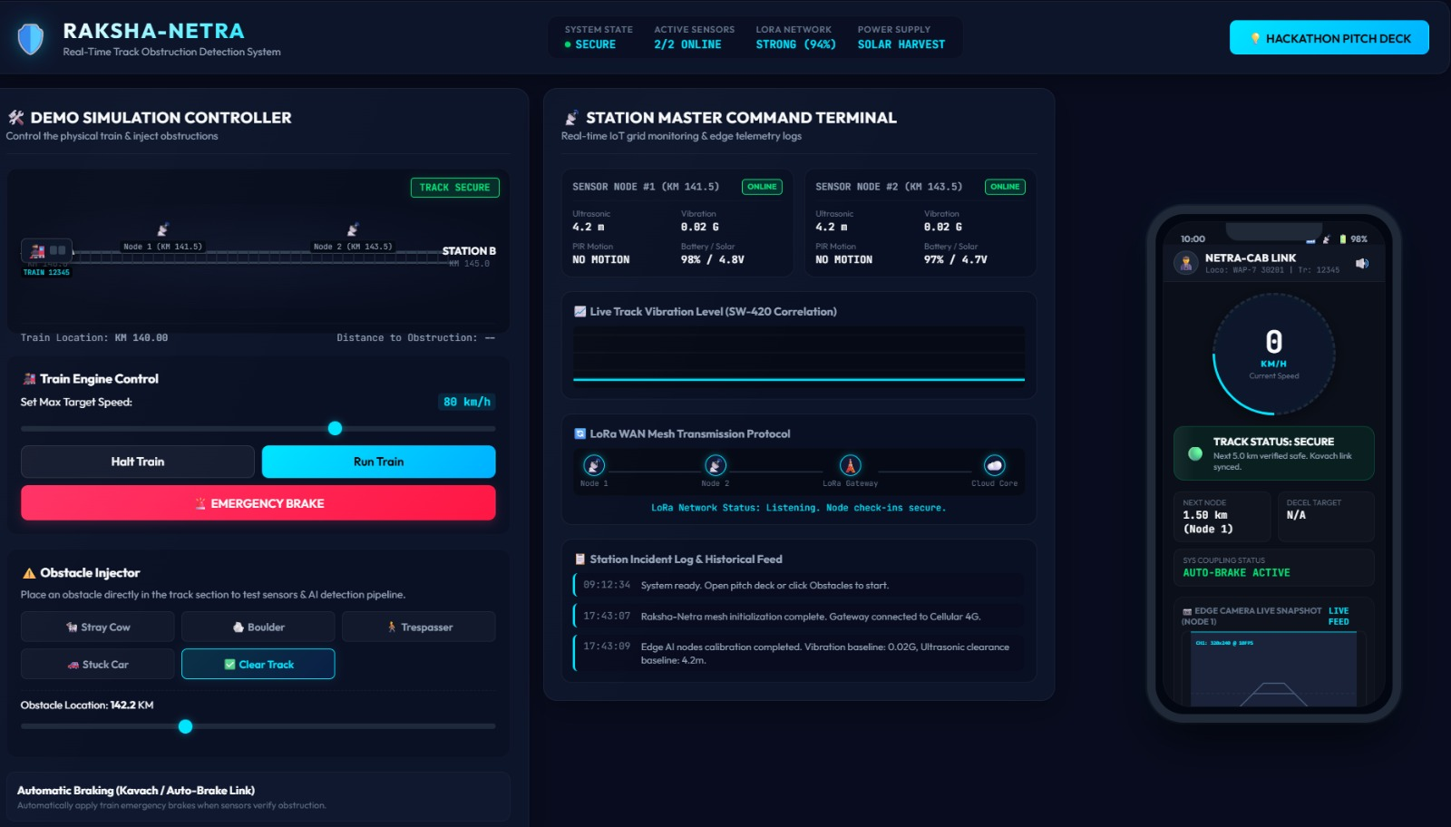
ONLINE DASHBOARD

Slide 11
COST COMPARISON
167× cheaper than radar — without sacrificing performance
Feature
RAKSHA-NETRA
Radar
Cost/km
₹36,000
₹50 Lakh
Power needed
Solar only
Grid + UPS
Cellular needed
No (LoRa)
Yes
Detection time
<1 second
1–2 seconds
AI on-device
Yes (Edge)
Cloud only
Retrofit cost
Minimal
Major infra

Slide 12

DEPLOYMENT ROADMAP
Phase 1 — PILOT
50 km
₹25 Lakh
6 Months
Vulnerable high-risk section. Validate detection accuracy, LoRa mesh reliability, solar uptime. Integrate with existing Kavach system.
Coverage
Investment
Timeline
Phase 2 — ZONE ROLLOUT
5,000 km
₹15 Crore
2 Years
All high-risk zones across one railway zone. Full station dashboard deployment. Alert API integration with train control.
Coverage
Investment
Timeline
Phase 3 — NATIONAL
68,000 km
₹200 Crore
5 Years
Full Indian Railways network coverage. Predictive analytics layer. Cross-zone data sharing and national safety dashboard.
Coverage
Investment
Timeline
Retrofittable alongside existing Kavach/ETCS infrastructure via open APIs — no rip-and-replace required

Slide 13

IMPACT AT SCALE
What full deployment across Indian Railways would mean
90%+
₹200Cr
Zero
Reduction in
track obstruction
fatalities
vs ₹34,000Cr
for radar network
(170× savings)
Grid power
required per
node
68,000
Carbon
<1s
km of Indian
Railways protected
when fully deployed
Net-zero
infrastructure
(solar powered)
End-to-end from
detection to
brake trigger

Slide 14
TECHNOLOGY STACK
🖥️ Simulator (Built)
⚙️ Hardware (Proposed)
HTML5
ESP32-CAM
Structure and layout
Edge MCU with camera module
CSS3
TFLite Micro
Glassmorphism dark theme + animations
INT8 MobileNetV2 — on-device AI
ES6 JavaScript
LoRa SX1278
All simulation logic — no frameworks
Long-range mesh radio (~5km)
Web Audio API
Firebase / AWS
Emergency alarm generation
IoT Core cloud backend + alerts
Canvas API
Kavach API
Track and train animation
Integration with existing safety systems

Slide 15
WHY RAKSHA-NETRA WINS
Four decisive advantages over every existing approach
On-Device AI — No Cloud Needed
Truly Off-Grid Deployable
TinyML runs on the node itself. No latency from cloud round-trips. No privacy risk. Works even when internet is unavailable — which it often is in rural India.
Solar + battery powers each node indefinitely. LoRa mesh needs no cellular infrastructure. Deploy anywhere on 68,000 km — including mountain passes, jungle cuts, remote crossings.
Near-Zero False Alarms
167× Cheaper — At Scale
Multi-sensor fusion (ultrasonic + PIR + vibration + vision) requires four independent signals before triggering an alert. Rain, birds, and debris are filtered out automatically.
₹36,000/km in production vs ₹50 lakh/km for radar. This is the difference between a ₹34,000 crore unaffordable project and a ₹200 crore achievable national rollout.

Slide 16
BUILD IT. DEPLOY IT. SAVE LIVES.
RAKSHA-NETRA is ready for a pilot. The simulator proves the pipeline works.
Step 1
Step 2
Step 3
Run the Simulator
Build a Hardware Prototype
Pilot on 50 km Track
Open the HTML file — no setup needed. Place obstacles. Watch the pipeline.
₹3,000 BOM. ESP32-CAM + LoRa module. TFLite model ready to flash.
Partner with Indian Railways. Integrate with Kavach. Measure. Scale.
RAKSHA-NETRA · AI-Powered Track Safety · Solar · LoRa · Edge-AI · <1s Response · ₹36,000/km

